Slide 1
MCA Final Year Project (Review II) IMMERSIVE AUGMENTED REALITY WARDROBE STYLIST
Submitted to the Presidency University, Bengaluru in partial fulfillment for the award of the degree of Master of Computer Applications(MCA)
Project Number : MCA_PR214
Under the supervision of
Mr. Sakthi S Assistant Professor Presidency School of Computer Science and Engineering
Name | Roll Number
Adnan Imam | 20232MCA0248

Slide 2
Content
Problem Statement
Literature Survey
Tools and Technologies to be used
Timeline of the Project
References

Slide 3
Problem Statement
Problem Definition:
Fashion choices can be overwhelming, and individuals struggle to visualize outfits before purchasing. Traditional online shopping lacks an immersive experience, leading to dissatisfaction and high return rates.
Relevance and Significance:
An augmented reality-based wardrobe stylist can enhance shopping experiences by allowing users to visualize outfits in real time, improving confidence in fashion choices and reducing returns.
Current Gaps in Existing Solutions:
Lack of personalization in virtual try-ons.
High computational requirements for real-time rendering.
Research-Oriented Approach:
This project aims to develop an interactive AR wardrobe that enables users to virtually try on clothes using machine learning and augmented reality techniques.

Slide 4
Literature Review
S. No | Title of Paper | Year | Methodology Used | Challenges Faced | Advantages | Disadvantages
1 | AI-Powered Fashion Recommendation System Using Deep Learning | 2023 | Deep Learning, Neural Networks | Requires large datasets, model interpretability issues | Enhanced recommendation accuracy, improved personalization | Requires continuous model training, privacy concerns
2 | A Study on AI-Based Personalized Fashion Recommendation Systems | 2023 | AI Algorithms, Recommendation Systems | Bias in recommendation systems, high dependency on user data | Better user engagement, higher conversion rates | Over-reliance on user data, potential inaccuracies
3 | Virtual Fashion Stylist with AI-Generated Wardrobe Capsule Suggestions | 2024 | Computer Vision, AI-based Virtual Assistants | Limited fashion dataset coverage, difficulty in trend adaptation | Automated styling, user-friendly virtual assistant | Limited scalability, high computation requirements
4 | AI-Driven Personalized Fashion Stylist | 2023 | Big Data Analytics, AI, Machine Learning | Scalability issues, difficulty in maintaining accuracy across regions | More precise fashion predictions, better shopping experiences | Data privacy concerns, requires significant processing power
5 | Augmented Reality for Virtual Try-On | 2021 | AR-based clothing visualization using computer vision | Device compatibility issues, latency in rendering | Enhanced shopping experience, reduces returns | High processing power needed

Slide 5
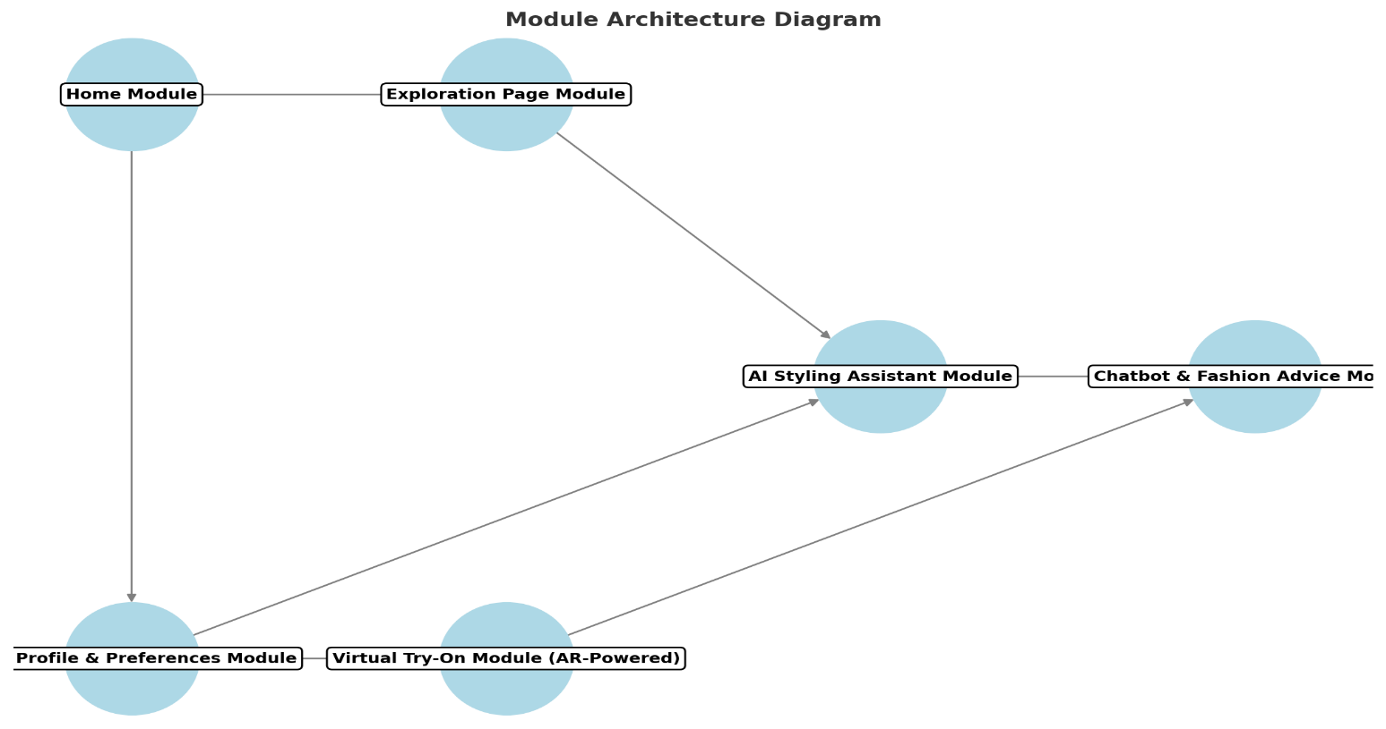
Module Design
The modular architecture of the project is designed to enhance scalability, maintainability, and efficiency by dividing the system into distinct, interdependent components. Each module focuses on a specific functionality, enabling seamless integration and easier debugging. It enables parallel development, optimized performance, and better security by isolating sensitive data within specific components.

Slide 6
Module Design
Modular Breakdown
Module 1: Home Module
Serves as the main dashboard, providing a personalized feed with fashion recommendations, user activity, and quick access to key features.
Acts as the central dashboard of the app, welcoming users upon login.
Displays a personalized feed with fashion suggestions based on preferences and recent activity.
Includes shortcuts to essential features such as Virtual Try-On, AI Stylist, and Wardrobe.
Updates dynamically with seasonal trends, user interactions, and new content.
Integrates social elements like user highlights, likes, and style ratings

Slide 7
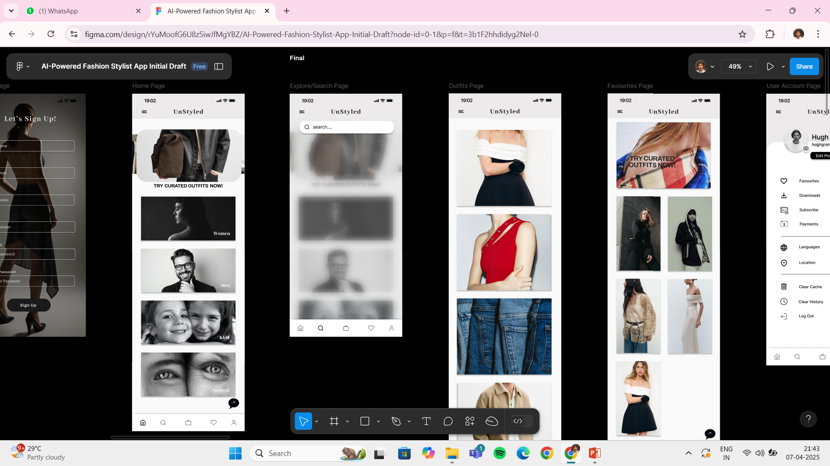
Screenshot of the Home Page

Slide 8
Module Design
Modular Breakdown
Module 2: Exploration Page Module
Allows users to explore trending styles, fashion inspirations, new collections, and AI-curated looks.
Offers a curated space to discover the latest fashion trends and collections.
Features AI-curated looks, influencer picks, and occasion-based outfit ideas.
Allows filtering by style, color, occasion, and trending tags.
Enables users to save or directly try looks via the Virtual Try-On feature.
Promotes real-time updates from fashion blogs and designer showcases.

Slide 9
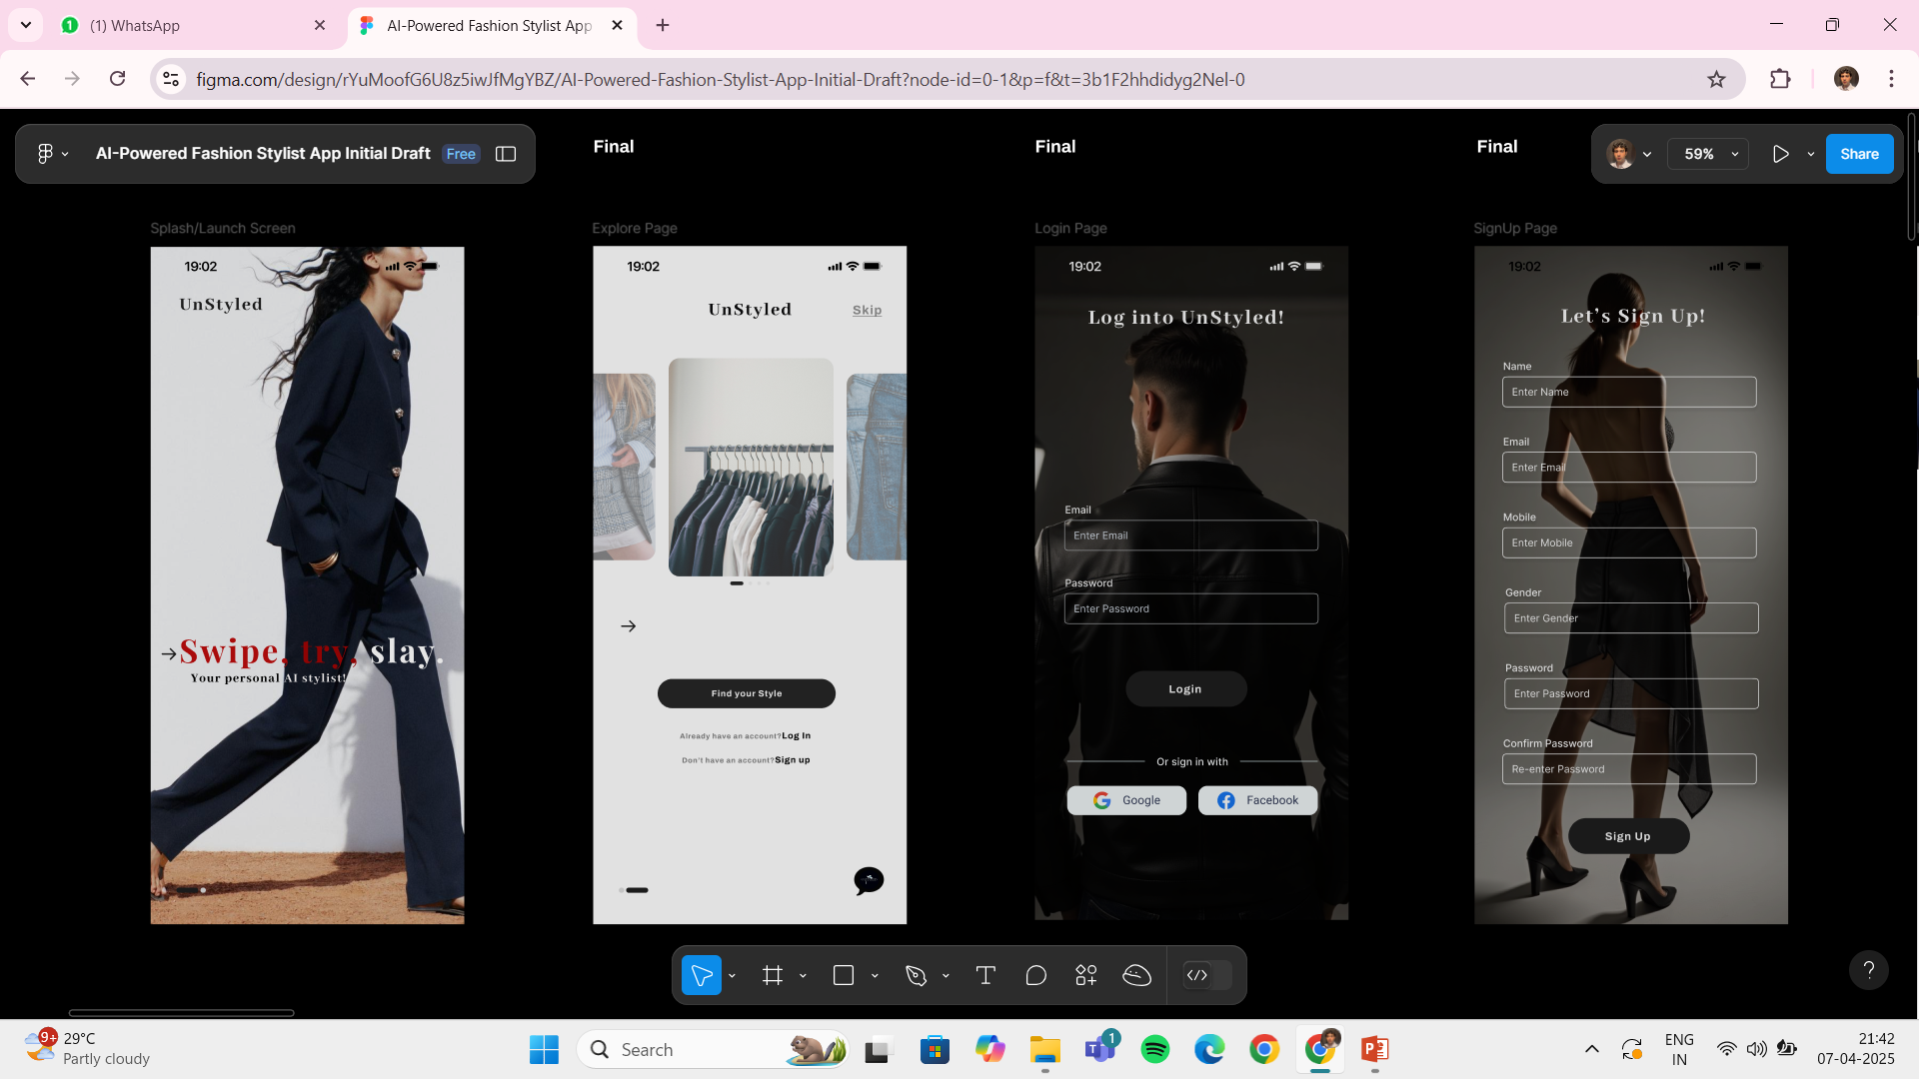
Screenshot of the Explore Page

Slide 10
Module Design
Modular Breakdown
Module 3: User Profile & Preferences Module
Stores user details, style preferences, wardrobe items, and past selections for a personalized experience.
Captures detailed user information including size, gender, and fashion interests.
Stores and updates style preferences through quizzes, selections, and behavior.
Displays saved items, past outfits, and browsing history.
Syncs wardrobe data for more accurate AI styling suggestions.
Supports easy editing and reconfiguration of profile and preferences.

Slide 11
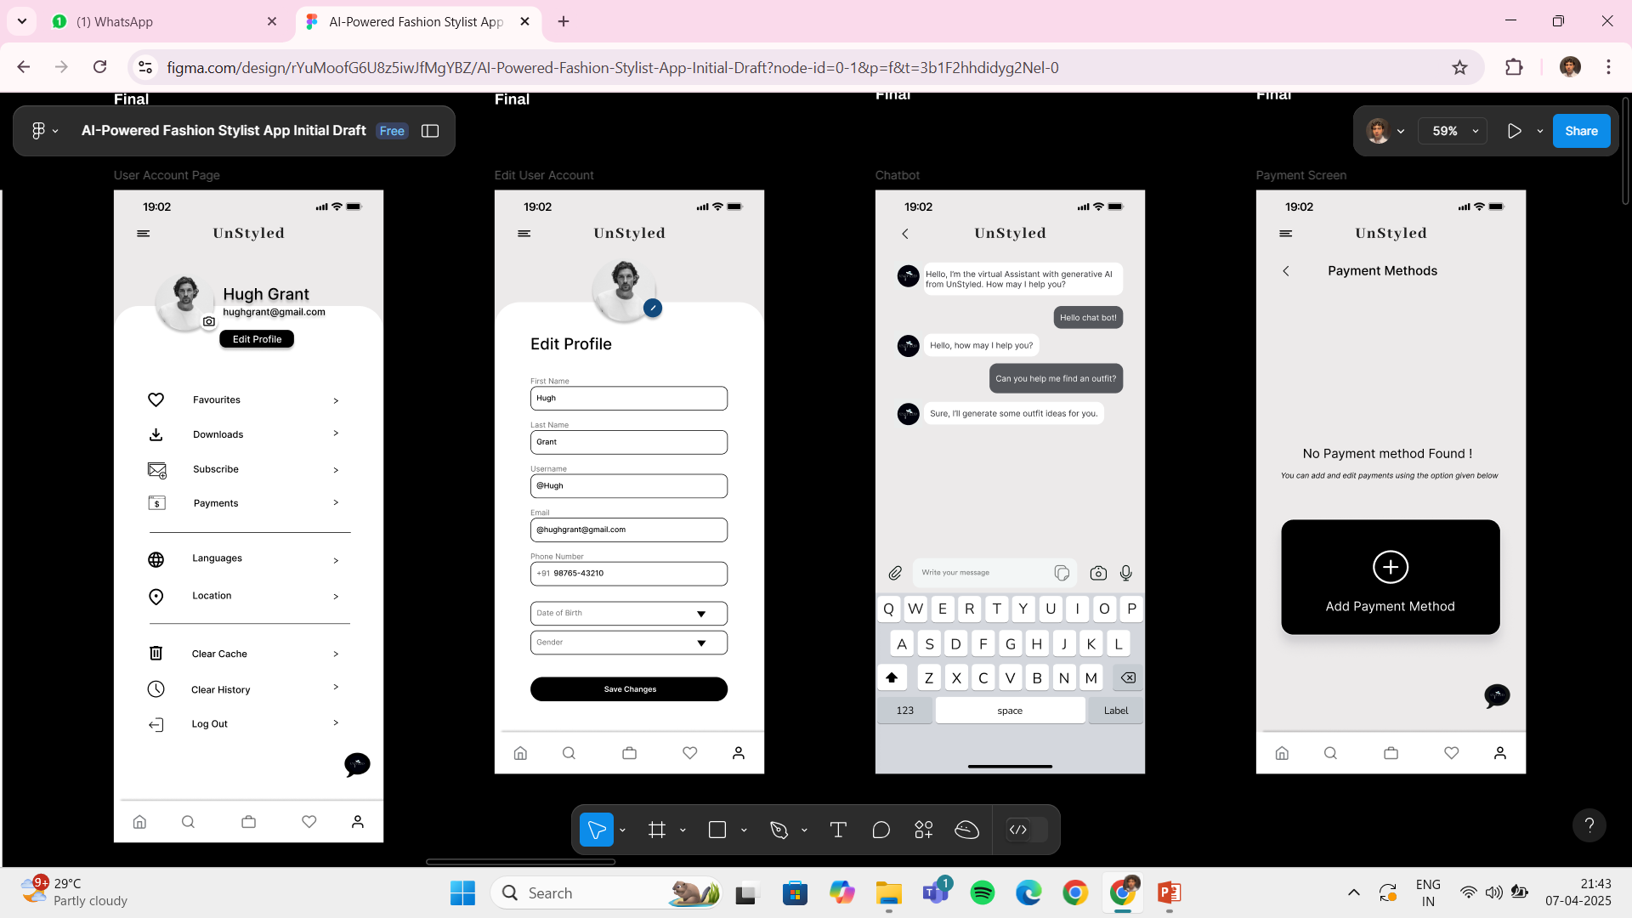
Screenshot of the User Account Page

Slide 12
Module Design
Modular Breakdown
Module 4: Virtual Try-On Module (AR-Powered)
Enables users to try on outfits virtually using augmented reality for better decision-making.
Utilizes AR technology to allow users to visualize outfits in real-time.
Enhances shopping decisions with accurate fitting previews on user avatars.
Supports multiple angles, zoom, and outfit swapping in one session.
Offers realistic fabric textures, color tones, and motion-based fitting.
Reduces product returns by helping users choose what suits them best.

Slide 13
Module Design
Modular Breakdown
Module 5: AI Styling Assistant Module
Provides personalized outfit recommendations based on weather, events, body type, and latest trends.
Leverages user data, current trends, and seasonal styles for tailored recommendations.
Offers complete lookbooks with accessories and footwear pairings.
Continuously learns and adapts to user tastes via machine learning.
Suggests alternate outfit combos to promote wardrobe reuse.

Slide 14
Module Design
Modular Breakdown
Module 6: Chatbot & Fashion Advice Module (NLP-Based)
Offers real-time fashion tips, trend analysis, and Q&A assistance via an AI-powered chatbot. Employs Natural Language Processing for conversational interactions.
Provides instant responses to queries like “What should I wear to a wedding?”
Shares fashion dos and don’ts, upcoming trends, and styling tips.
Connects users to community discussions and expert opinions.
Available 24/7, mimicking a personal fashion consultant experience.

Slide 15
Screenshot of the Chatbot and AI Assistance Page

Slide 16
Module Design
Modular Breakdown
Module 7: Wardrobe Management Module
Helps users organize, categorize, and mix-match their existing wardrobe for better outfit planning.
Digitally catalogs the user’s wardrobe with item details and photos.
Allows tagging, categorization (formal, casual, etc.), and outfit history.
Features mix-and-match tools for creating new outfits from existing items.
Tracks outfit usage and suggests lesser-used pieces for styling ideas.
Integrates with AI Styling Assistant for smart look generation.

Slide 17
Screenshot of the Wardrobe Management Page

Slide 18
Additional Screenshots of the System

Slide 19
Screenshots of the System

Slide 20
Screenshots of the System

Slide 21
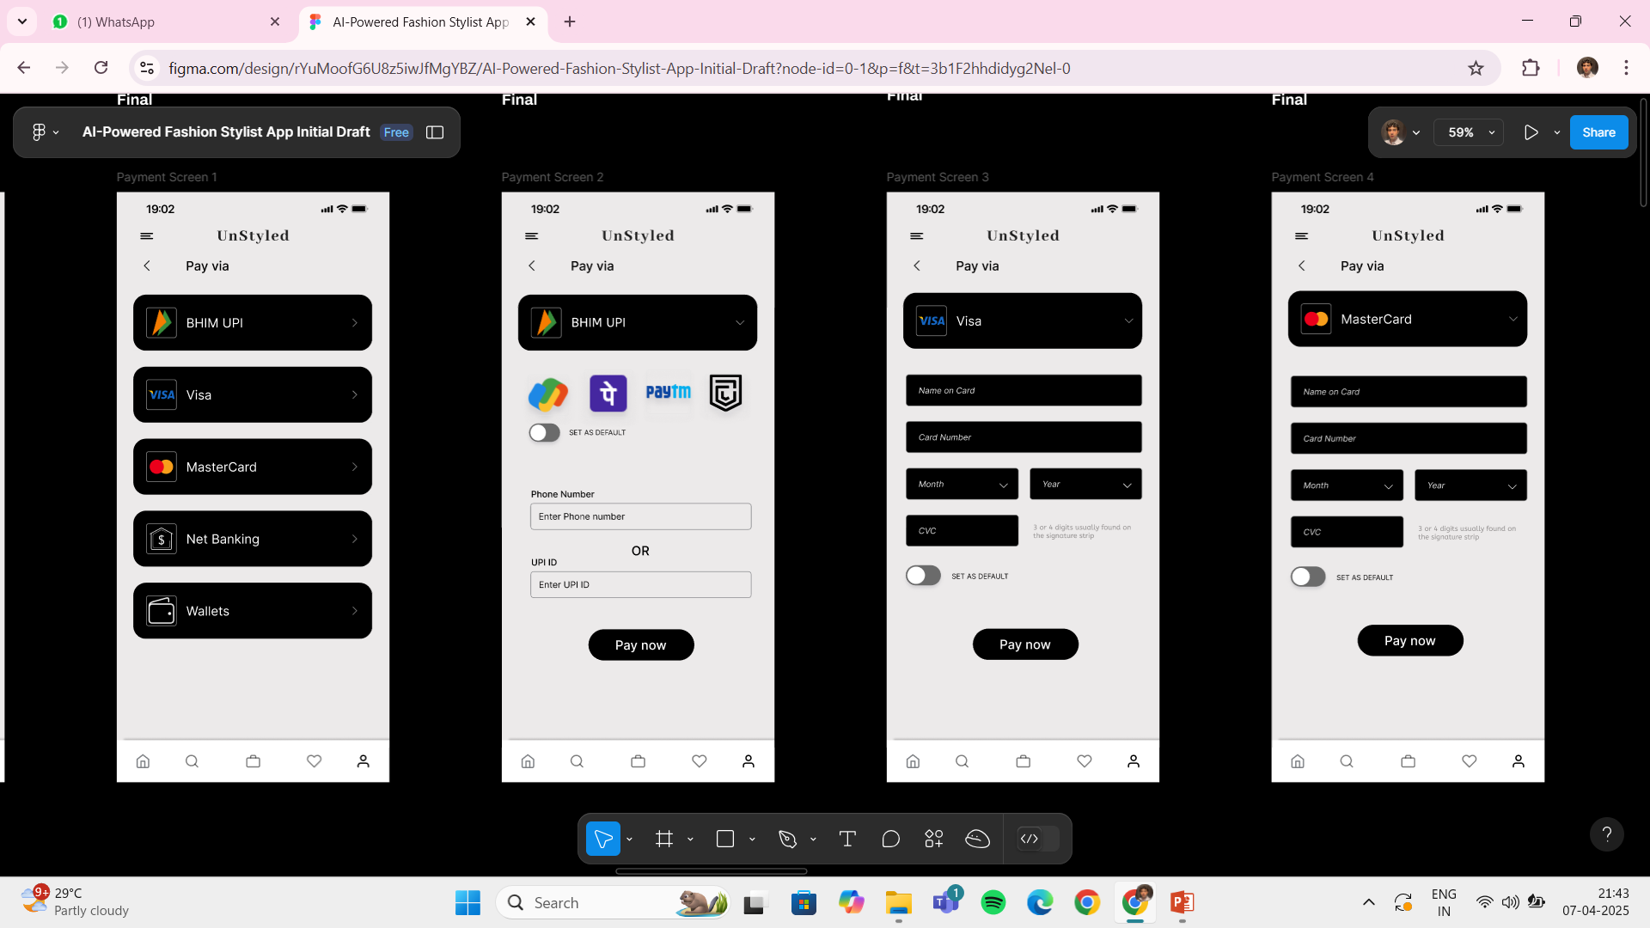
Screenshots of the System

Slide 22
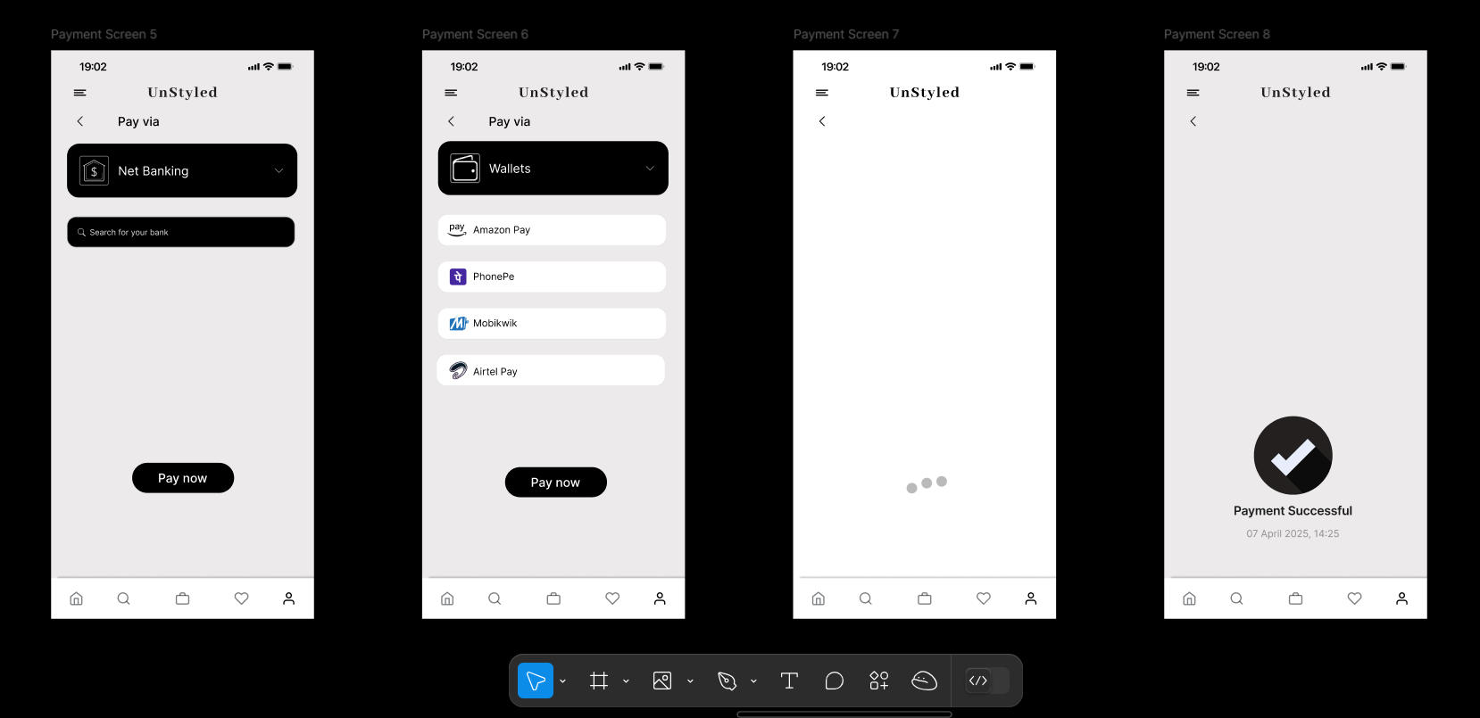
Screenshots of the System

Slide 23
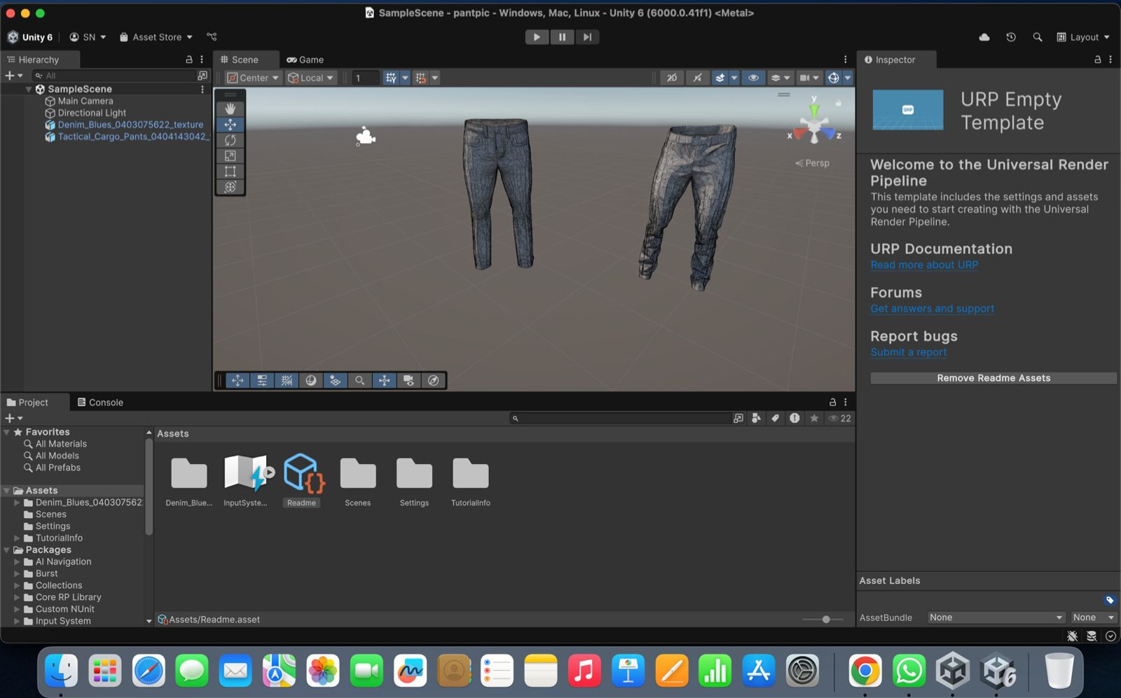
Screenshots of the System

Slide 24
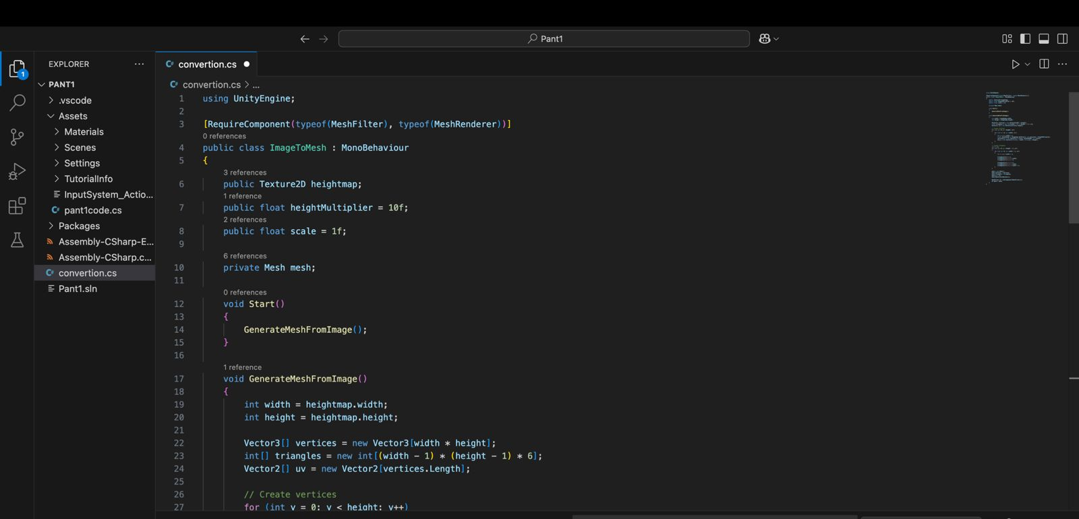
Screenshots of the System

Slide 25
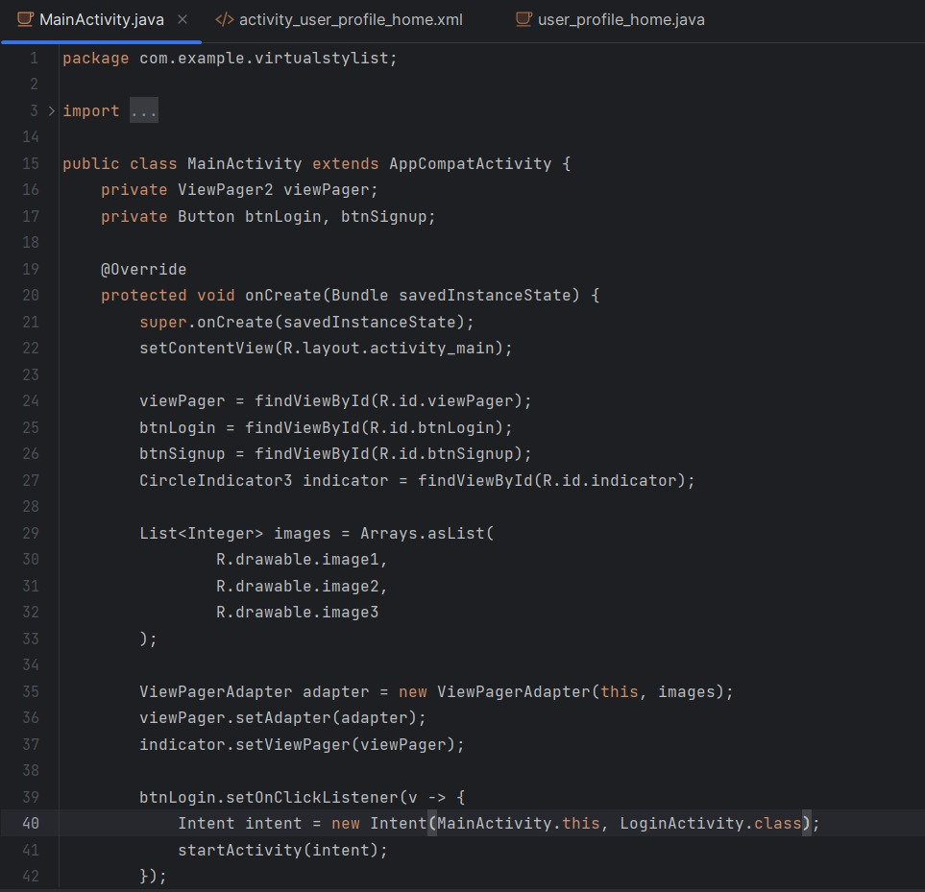
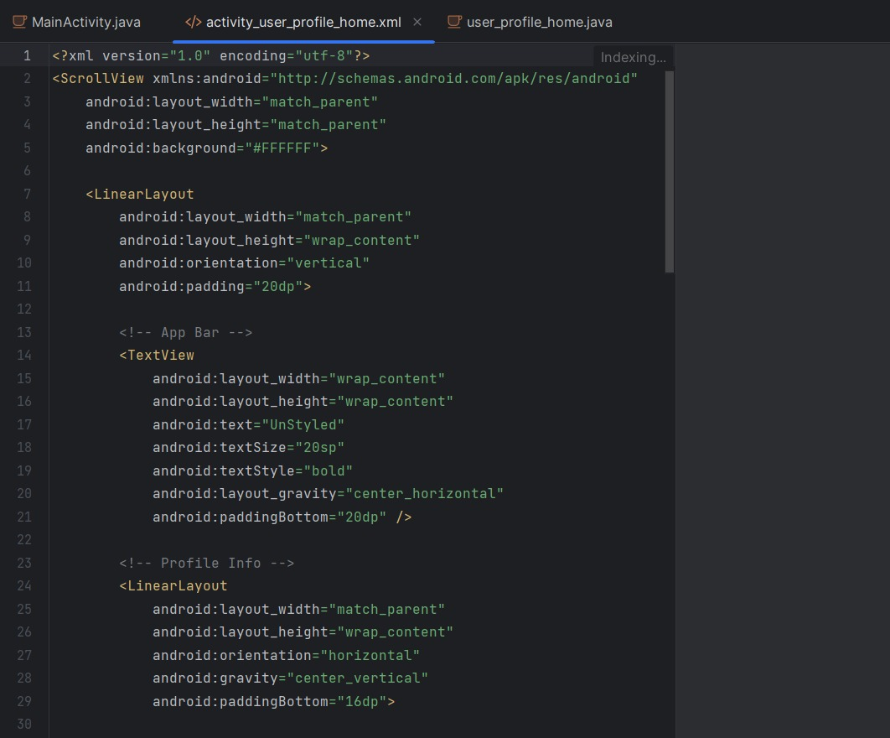
Screenshots of the System

Slide 26
Tools And Technologies To Be Used
Development Tools: Android Studio, VS Code
Programming Languages: Dart, JavaScript, Python
Frameworks/Libraries: Flutter, React Native, TensorFlow, PyTorch, ARCore, ARKit
Database: Firebase, Flask/Django
Version Control: Git, GitHub
Additional Tools: Google Colab (Cloud Training), Figma (UI/UX), Sketchfab/Blender (3D Models)

Slide 27
Github Link
Immersive-Augmented-Reality-Wardrobe-Stylist-

Slide 28
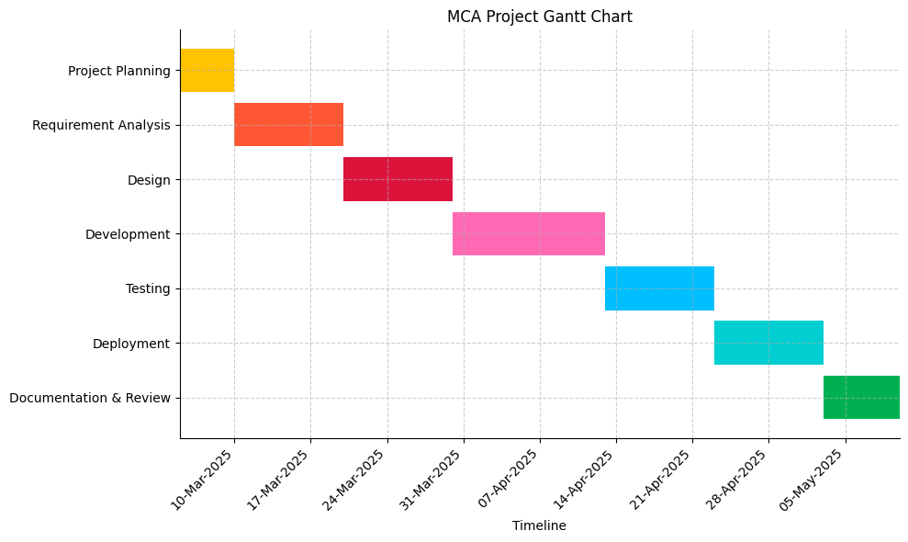
Timeline of the Project (Gantt Chart)

Slide 29
References
Karthik, M., Sharma, A., Raj, A., & Jeyakumar, P. (2023). AI-powered fashion recommendation system using deep learning. Fashion and Textiles, 10(1), 1-16. https://fashionandtextiles.springeropen.com/counter/pdf/10.1186/s40691-023-00360-w.pdf
Kumar, S., Patel, R., & Sharma, V. (2023). A study on AI-based personalized fashion recommendation systems. International Journal of Research Publication and Reviews, 5(12), 412-419. https://ijrpr.com/uploads/V5ISSUE12/IJRPR36107.pdf
Srishti, K. P., Taj, S., Prerana, D. V., Hegde, S. U., & Singh, T. S. B. (2024). Virtual fashion stylist with AI-generated wardrobe capsule suggestions. Journal of Emerging Technologies and Innovative Research, 11(11), 311–314.
https://www.jetir.org/papers/JETIR2411533.pdf
Udavant, O., Kumari, R., Kumar, R., & Chikane, M. (2023). AI-driven personalized fashion stylist. International Research Journal of Modernization in Engineering, Technology and Science, 5(11), 2363–2364. https://www.irjmets.com/uploadedfiles/paper//issue_11_november_2023/46594/final/fin_irjmets1700834106.pdf

Slide 30
References
AI-Powered Fashion Recommendations (2022)- This paper discusses the integration of AI in fashion recommendation systems, focusing on machine learning algorithms to enhance user experience. Custom AI Agents | Springs
Smart Wardrobe Management Using AI (2023)- This research focuses on AI applications in managing personal wardrobes, offering outfit suggestions based on user preferences. LeewayHertz - AI Development Company
Shaghayegh Shirkhani, Hamam Mokayed, Rajkumar Saini, Hum Yan Chai (2023). Study of AI-Driven Fashion Recommender Systems. A Springer Nature Journal. SN Computer Science 4:514 https://link.springer.com/article/10.1007/s42979-023-01932-9
Orestis Sarakatsanos, Anastasios Papazoglou‑Chalikias, Machi Boikou, Elisavet Chatzilari, Michaela Jauk, Ursina Hafiger, Spiros Nikolopoulos, Ioannis Kompatsiaris (2024). VR Designer: enhancing fashion showcases through immersive virtual garment fitting. A Springer Nature Journal. Virtual Reality (2024) 28:70 https://link.springer.com/article/10.1007/s10055-024-00945-w

Slide 31


